Slide 1
KUBERNETES

Slide 2
Understanding Kubernetes Architecture

Slide 3
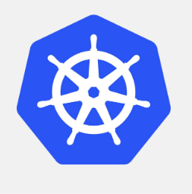
What is Kubernetes?
Open source platform designed to automate deploying, scaling, and operating application.
Deploy applications quickly and predictably.
Scale applications on the fly
Roll out new features seamlessly
Limit hardware usage to required resources only.
The goal of Kubernetes is to foster an ecosystem of components and tools that relieve the burden of running applications in public and private clouds.

Slide 4
What is Kubernetes?
Open source orchestration tool for application containers developed by Google.
It packages all of the necessary tools - orchestration, service discovery and load balancing in one place.
Kubernetes is portable
It can be deployed on public, private, hybrid along with multiple cloud platform providers.
It is developed to manage Docker containers.

Slide 5
Kubernetes is
Portable
Extensible
Self-healing

Slide 6
Kubernetes is
Portable
Public Cloud
Private Cloud
Hybrid Cloud
Multi Cloud

Slide 7
Kubernetes is
Extensible
Modular
Pluggable
Hookable
Composable

Slide 8
Kubernetes is
Self-healing
Auto-placement
Auto-restart
Auto-replication
Auto-scaling

Slide 9
Where Did Kubernetes Come From?
Google started the Kubernetes project in 2014
Kubernetes builds upon the experience that Google has with running production workloads at scale
Combine this with the ideas and practices from an active open source community and Kubernetes was born

Slide 10
What Kubernetes Is Not
Kubernetes is not a traditional all-inclusive PaaS system
Does not limit the types of applications supported
Does not provide middleware (message bus), data processing framework (Spark), database (mysql), nor cluster storage (Ceph)
Does not have a click-to-deploy service markeplace
Does not deploy source code or build your application
Does not dictate monitoring, logging, or alerting decisions
But.. PaaS solutions can run on top of Kubernetes (Openshift)

Slide 11
What Does Kubernetes Mean?
The name Kubernetes originates from Greek, meaning helmsman or pilot
K8s is am abbreviation derived by replacing the 8 letters “kubernet” with “8”

Slide 12
Kubernetes – Container Orchestration at Scale
Container Cluster Manager
Inspired by the technology that runs Google
Runs anywhere
Public cloud
Private cloud
Bare metal
Strong ecosystem
Partners : Red Hat, VMWare, CoreOS..
Community : clients, integration

Slide 13
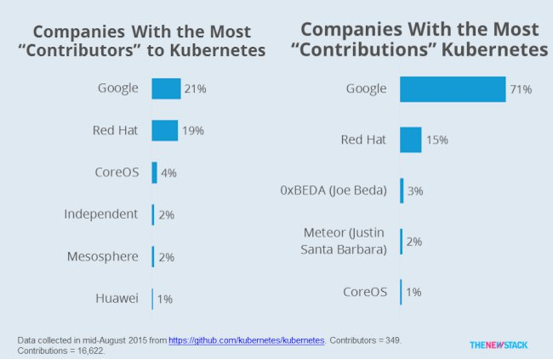
Kubernetes Contributors

Slide 14
Kubernetes provides
Scheduling
Lifecycle and health
Discovery
Monitoring
Auto Scaling
Self-healing
Persistence

Slide 15
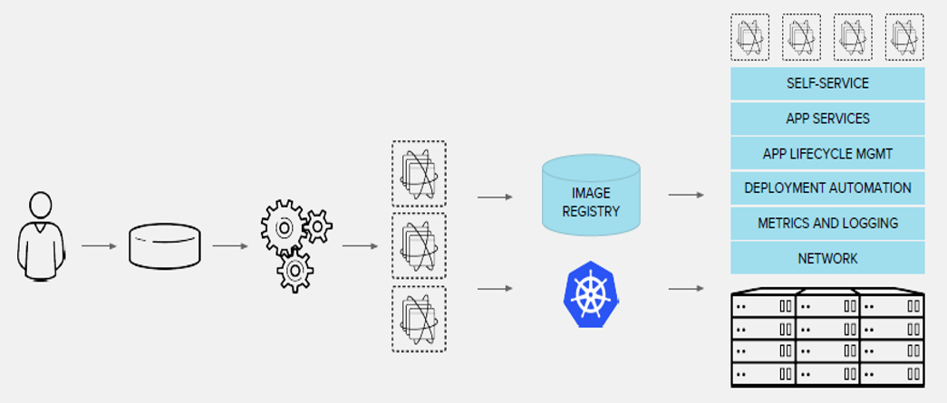
Container and Kubernetes

Slide 16
Why Containers?
Operating system virtualization rather than hardware virtualization
Containers are isolated from each other and from the host
Containers have their own filesystems, they can’t see each others processes, and resource usage can be bound
Containers are easier to build than VMs
Because cantainers are decoupled from the underlying infrastructure and the host filesystem, they are portable across clouds and OS distributiuons

Slide 17
Container Benefits
Agile application creation and deployment
Continuous development, integration, and deployment
Dev and Ops seperation of concerns
Environmental consistency across development, testing, and production
Cloud and OS distribution portability
Loosely couple distribution, elastic, liberated micro-services

Slide 18
Why Kubernetes?
At minimum Kubernetes can schedule and run application containers on clusters of physical or virtual machines
Kubernetes allows Developers to move from a host-centric infrastructure to a container-centric infrastructure

Slide 19
Why Kubernetes?
Kubernetes satisfies common needs for applications in production
Mounting storage systems
Distributing secrets
Checking application health
Replicating application instances
Using horizontal Pod Autoscaling
Naming and discovery

Slide 20
Why Kubernetes? (continued)
Kubernetes satisfies common needs for applications in production
Balancing loads
Rolling updates
Monitoring resources
Accessing and ingesting logs
Debugging applications
Providing authentication and authorization

Slide 21
Kubernetes architecture

Slide 22
Pets vs Cattle
When they get ill you nurse them back. You name them! And take care of them
Eg: Virtual Machine
When they get ill you get another one
They are almost identical to one another
Don’t have specific names. Give numbers
Can be simply replaced if they die
Eg; Container

Slide 23
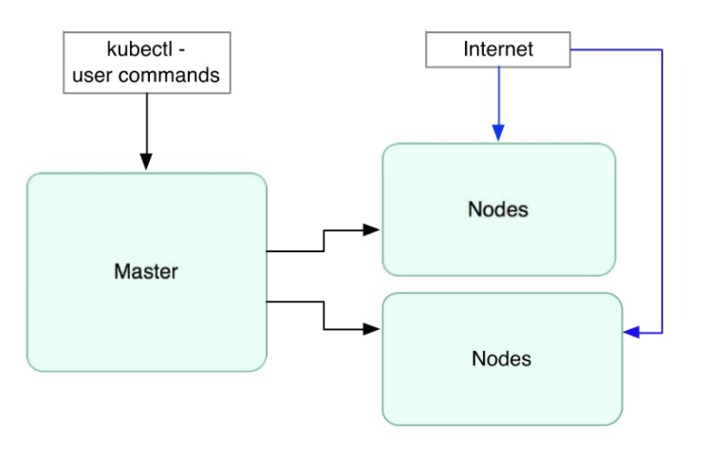
High Level Components

Slide 24
Kubernetes terminologies
Master: Manages the Kubernetes cluster, including assigning pods to nodes, etc.
Node: Worker machine in Kubernetes, earlier known as minion.
Deployment: Controller which manages the pods.
Pod: Group of one or more containers for an application which runs on the single minion or node.
Replica set: Desired number of pods which needs to be running always.
Service: Endpoint that exposes the ports to the outside world and mapped the port to the container port (target port)

Slide 25
Kubernetes terminologies (Conti…)
Labels: Labels for identifying pods
Kubelet: Container Agent
Proxy: A load balancer for Pods
etcd: A metadata service
cAdvisor: Container Advisor provides resource usage/performance statistics
Scheduler: Schedules pods in worker nodes
API Server: Kubernetes API Server

Slide 26
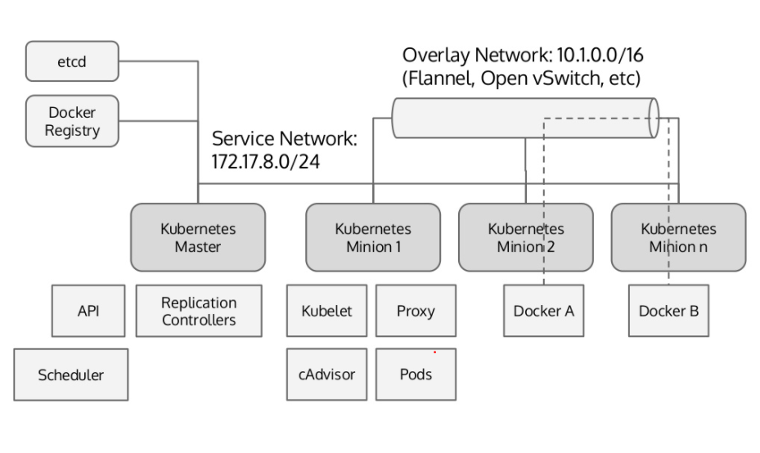
Kubernetes Architecture

Slide 27
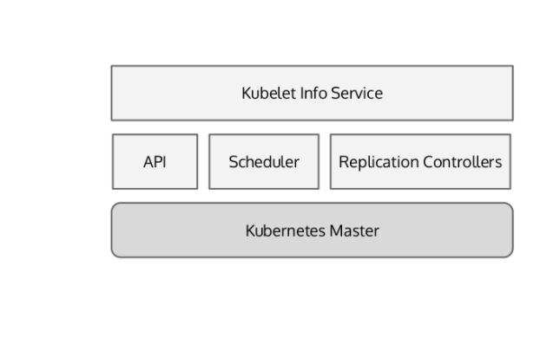
Kubernetes Master

Slide 28
Master
Master maintains the state of the Kubernetes Server runtime
State is maintained in the etcd backend
It is the point of entry for all the client calls to configure and manage Kubernetes components like Nodes, Pods, Replication Controllers and Services

Slide 29
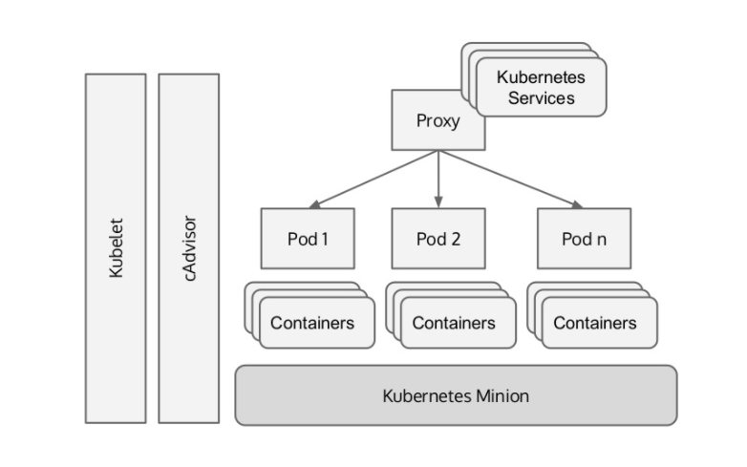
Kubernetes Minion (Worker Node)

Slide 30
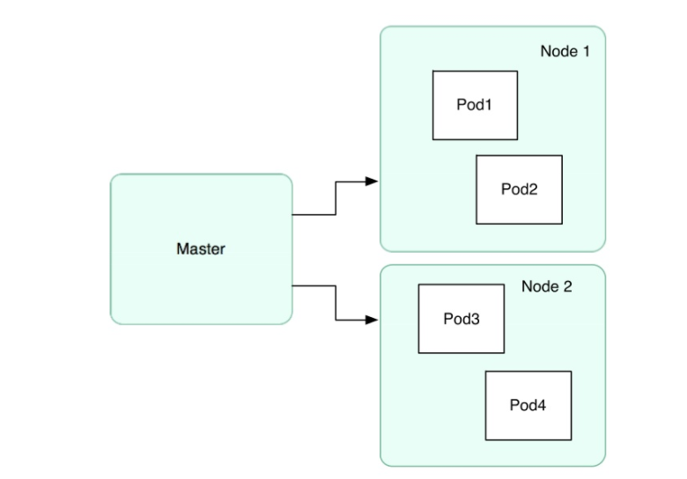
Relation between a Node and a Pod

Slide 31
Pod
Group of Containers
Related to each other
Share namespace
Ephemeral
Examples:
Wordpress + MySQL
ELK
Nginx + Logstash
Auth + Proxy + PHP
App + data-load

Slide 32
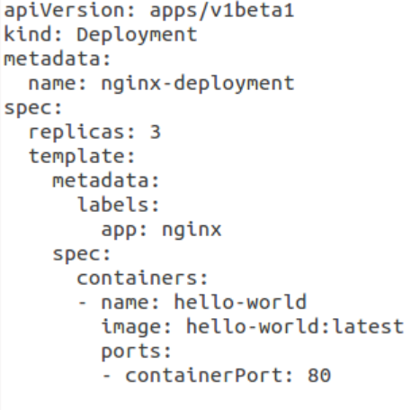
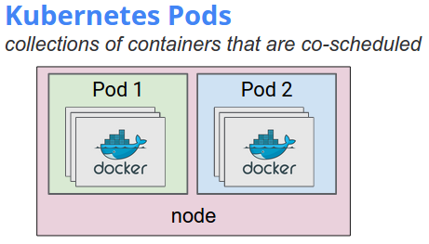
Pods Example

Slide 33
Kubernetes CLI
kubectl is an command line tool
Used for creating/deleting/retrieving deployments, pods, services, HPA (Horizontal Pod Auto-scaling), etc.
Basically a utility to run commands on the kubernetes cluster

Slide 34
Useful commands
kubectl describe nodes
List of the minion nodes in the cluster
kubectl describe nodes <node name>
Provides some extra information about the node including Name, labels, resource limits.
kubectl get deployment <options>
List of deployments, its age, desired and current capacity of the pods, number of available pods

Slide 35
What is YAML?
YAML Ain’t Markup Language (depending who you ask) is a human-readable text-based format for specifying configuration-type information
Ex: Kubernetes, SDN, and OpenStack

Slide 36
Why is YAML in k8s?
Convenience: You’ll no longer have to add all of your parameters to the command line
Maintenance: YAML files can be added to source control, so you can track changes
Flexibility: You’ll be able to create much more complex structures using YAML than you can on the command line

Slide 37
YAML Basic Rules – Syntax
YAML files should end in .yml
YAML is case sensitive
YAML does not allow the use of tabs. Spaces are used instead as tabs are not universally supported
List members are denoted by a leading hyphen (-)
Associative arrays are represented using the colon space (:) in the form key: value

Slide 38
Why configuration files using YAML rather than JSON
They can be used interchangeably in almost all scenarios, but YAML tends to be more user-friendly for configuration.
Easy to understand
Indented delimiting
Non-hierarchical data models

Slide 39
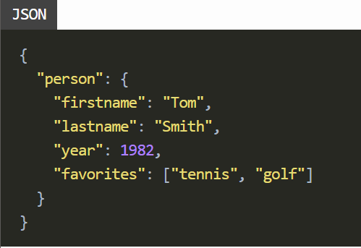
YAML vs JSON
JSON (JavaScript Object Notation)
Widely used for a client and a server communication
Simpler way to represent the data compared to XML(Extensible Markup Language)
No opening and closing tags in JSON

Slide 40
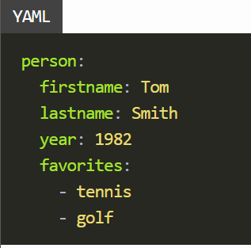
YAML vs JSON (Cont.)
YAML (YAML Ain’t Markup Language)
Simpler way than JSON to represent the data
Removes curly brackets({}) and squared brackets([]) except for inline collections
YAML is a superset of JSON.
Possible to convert YAML to JSON and JSON to YAML

